Slide 1
EN 55022:1998
Basic Training
EN 55022:1998+A1
Information technology equipment
Notes:
Efsdfgdf

Slide 2
EN 55022:1998
Definitions
Information technology equipment (ITE)
A) which has a primary function of either entry, storage, display, retrieval, transmission, processing, switching , or control, of data and of telecommunication messages
B) with a rated supply voltage < 600V
Notes:
Efsdfgdf

Slide 3
EN 55022:1998
Module
Part of an ITE which provides a function and may contain radio-frequency sources
Host unit
Part of an ITE system or unit that provides the mechanical housing for modules
Notes:
Efsdfgdf

Slide 4
EN 55022:1998
Scope and object
This publication applies to ITE
Notes:
Efsdfgdf

Slide 5
EN 55022:1998
Classification
Class B : use in the domestic environment
no fixed place of use;
personal computers and auxiliary connected equipment.
telecommunication terminal equipment powered by a telecommunication network;
Notes:
Efsdfgdf

Slide 6
EN 55022:1998
Class A :
a category of all other ITE which satisfies the class A ITE limits but not the class B ITE limits
Warning:
This is a class A product. In a domestic environment this product may cause radio interference in which case the user may be required to take adequate measures.
Notes:
Efsdfgdf

Slide 7
EN 55022:1998
Test Items
Conducted disturbance at mains terminals and telecommunication ports
Radiated disturbance
Notes:
Efsdfgdf

Slide 8
EN 55022:1998
General measurement conditions
Configuration
? personal computer
? point of sale terminal
Notes:
Efsdfgdf

Slide 9
EN 55022:1998
Operation
the typical use (rated voltage, typical load)
ensure that various parts of a system work
the determined operational mode an rationale for the conditions shall be stated in the test report.
Notes:
Efsdfgdf

Slide 10
EN 55022:1998
In the test report
selection of the configuration and loading of ports
the number and type of modules
for selecting units
Note:
Any set of results shall be accompanied by a complete description of the cable and equipment orientation (cable length, cable type, shielding)
Notes:
Efsdfgdf

Slide 11
EN 55022:1998
Set up
for both table-top and floor-standing operation shall be tested only in the table-top
For wall-mounted operation shall be tested as for the table-top
Notes:
Efsdfgdf

Slide 12
EN 55022:1998
Method of measurement of CE
Equipments
Receiver
Artificial mains network
Current probe
Capacitive voltage probe
Impedance stabilization network (ISN)
Notes:
Efsdfgdf

Slide 13
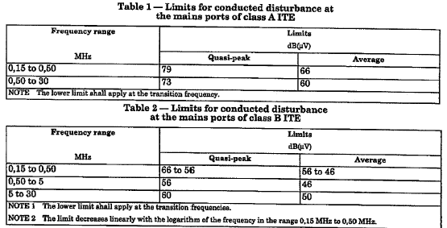
EN 55022:1998
Limits for CE at the mains ports
Notes:
Efsdfgdf

Slide 14
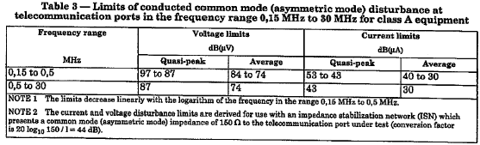
EN 55022:1998
Limits for CE at the telecommunication ports
Notes:
Efsdfgdf

Slide 15
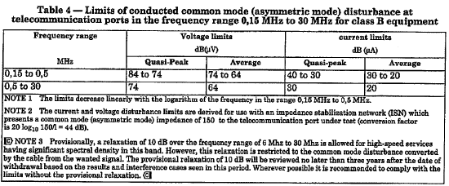
EN 55022:1998
Limits for CE at the telecommunication ports
Notes:
Efsdfgdf

Slide 16
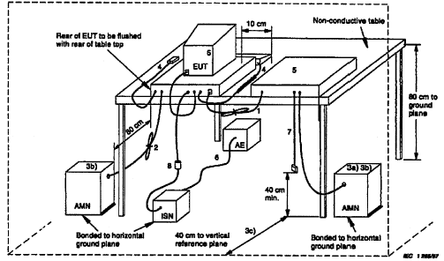
EN 55022:1998
SETUP For TABLE-TOP
Notes:
Efsdfgdf

Slide 17
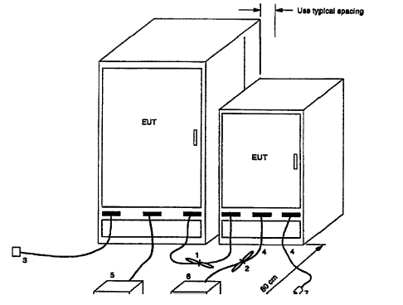
EN 55022:1998
SETUP For FLOOR-STANDING
Notes:
Efsdfgdf

Slide 18
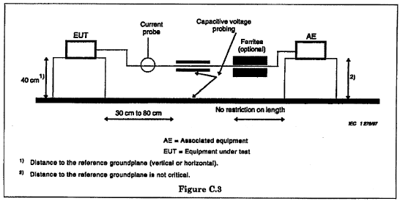
EN 55022:1998
Setup for CE at telecommunication ports
Notes:
Efsdfgdf

Slide 19
EN 55022:1998
Method of measurement of RE
Equipments
Receiver
Artificial mains network
Antenna (balanced dipole)
Notes:
Efsdfgdf

Slide 20
EN 55022:1998
Method
Pretest for finding the max emissions
adjust the length of the antenna
F < 80MHz, the L = 80MHz resonant length
F ≥ 80MHz, the L = resonant in length
Antenna shall be adjusted 1m ~ 4m
Notes:
Efsdfgdf

Slide 21
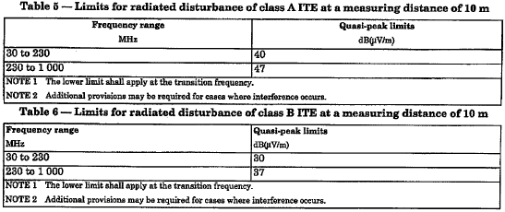
EN 55022:1998
Limits for RE
Notes:
Efsdfgdf

Slide 22
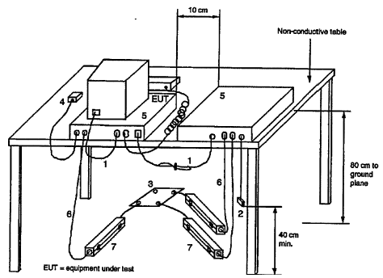
EN 55022:1998
Setup for table-top
Notes:
Efsdfgdf

Slide 23
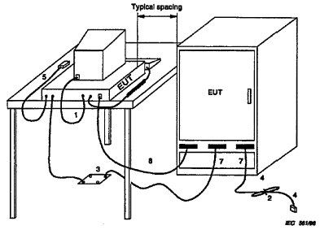
EN 55022:1998
Setup for floor-standing
Notes:
Efsdfgdf

Slide 24
EN 55022:1998
Recording of measurements
those disturbances above (L-20dB), record at least the disturbance levels and the frequencies of the sic highest disturbances from each mains or telecommunication port
record the antenna polarization for each reported disturbance for RE test
Notes:
Efsdfgdf

Slide 25
EN 55022:1998
Thank you

Notes:
Efsdfgdf

